Slide 1
Weekly Update #7
Gijs Admiraal

Slide 2
Recap from previous weeks
Started exploring topics: atom-by-atom generation, non-standard amino acids (nsAA), (chemical) language models, data augmentation and 3Di
Started creating protein SMILES dataset with RDKit
Created a mind map
Brainstormed on scenarios

Slide 3
What I have done
Worked out the four scenarios
Explored 3Di further
Worked on creating SMILES dataset and 3Di dataset
Ran into problems with the size of all .pdb files
Found a way to obtain 3Di sequence
But I ran into problems with the size (200.000+ proteins) of all .pdb files
Maybe perform a length screening beforehand
Still looking into atom reordering

Slide 4
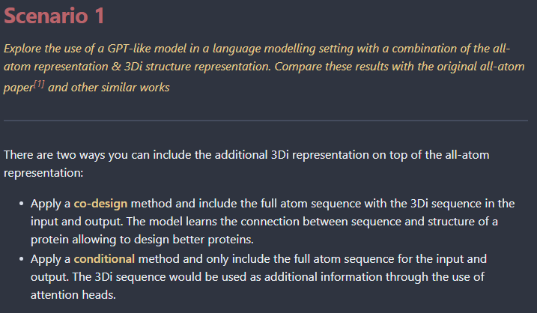

Slide 5
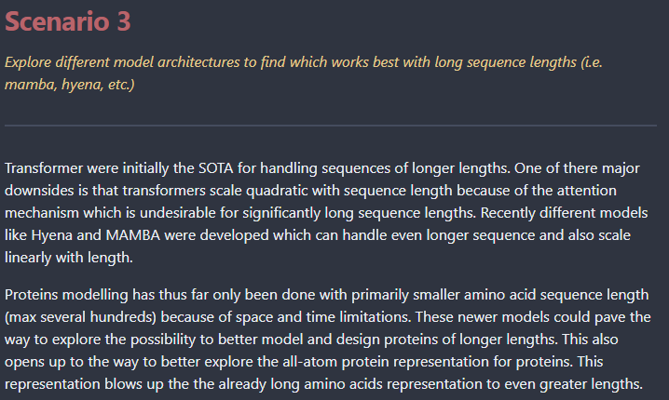

Slide 6
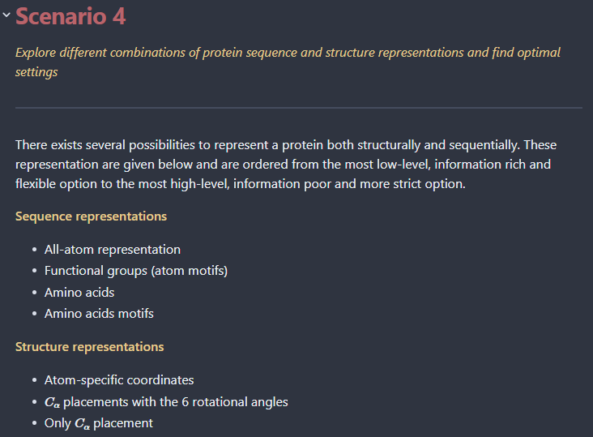

Slide 7
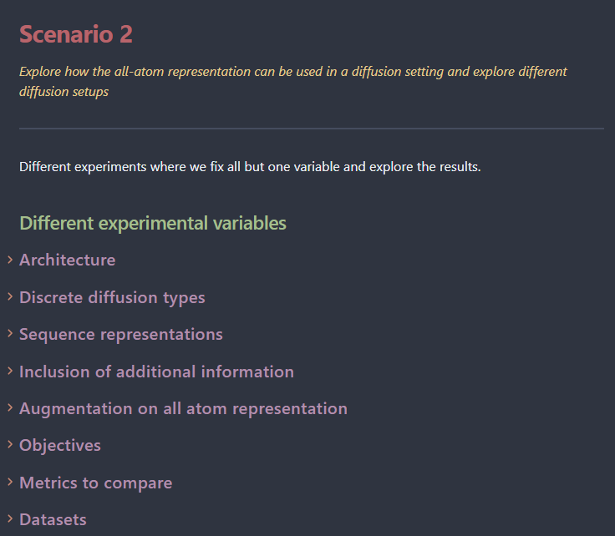

Slide 8
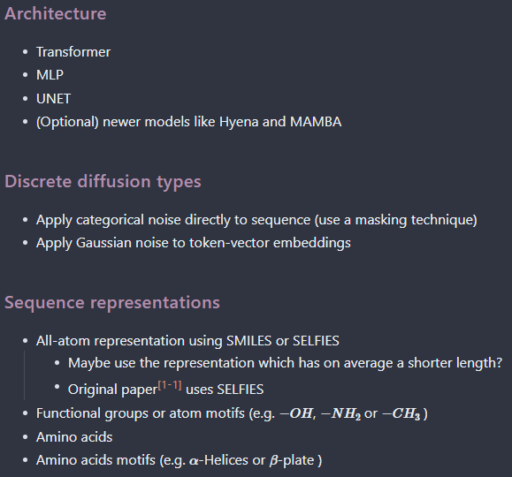
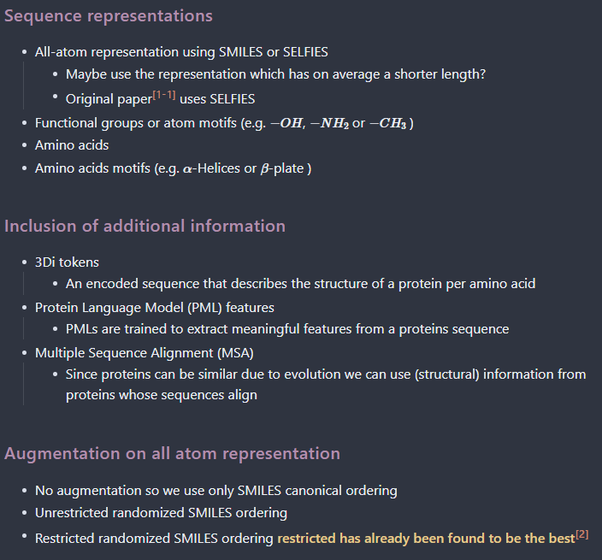
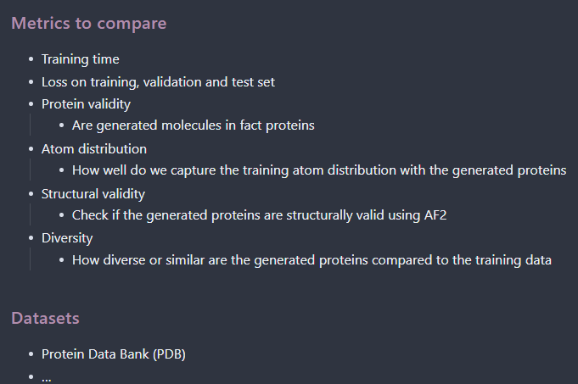

Variables

Slide 9
Research question
What is the [EVALUATION] performance and how does it compare to other models [MODELS] when a [DIFFUSION TYPE] & [ARCHITECTURE] diffusion model for generative protein design is trained on [DATASET] proteins represented using the SELFIES representation using
[OBJECTIVE]?
[ADDITIONAL INFO]

Slide 10
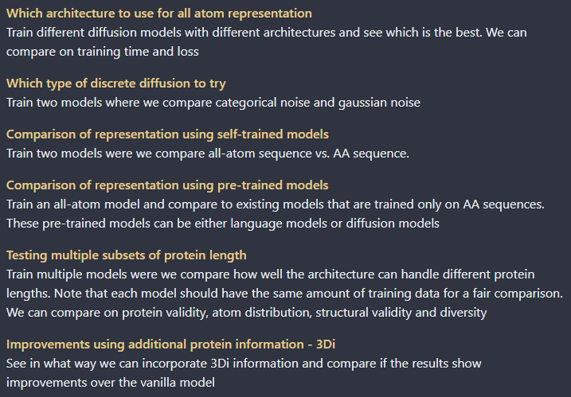
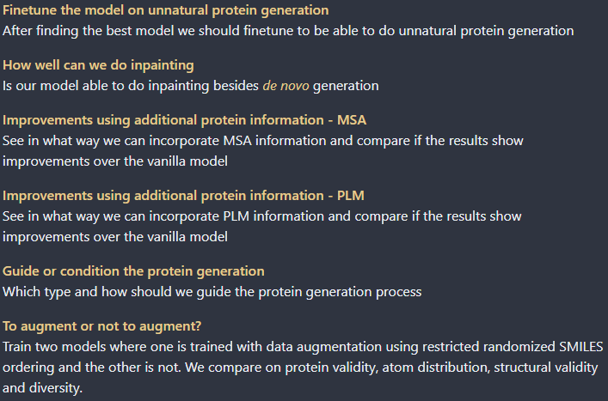
Experiments sorted on importance

Slide 11
What I have done
Worked out the four scenarios
Explored 3Di further
Worked on creating SMILES dataset and 3Di dataset
Found a way to obtain 3Di sequence
But I ran into problems with the size (200.000+ proteins) of all .pdb files
Maybe perform a length screening beforehand
Still looking into atom reordering

Slide 12
3Di – What is it?
“For FoldSeek, we developed a type of structural alphabet that does not describe the backbone but, rather, tertiary interactions.” ¹
Extracts structural features from a protein and uses an VQ-VAE to convert to 3Di sequence
“the encoder predicts the best matching 3Di state for each residue.” ¹
“To select nearest-neighbor residues that maximize the performance of the resulting 3Di alphabet in finding and aligning homologous structures, we introduced the virtual center V of a residue. The virtual center position is defined by the angle θ, the dihedral angle τ and the length l” ¹

Slide 13
What I have done
Worked out the four scenarios
Explored 3Di further
Worked on creating SMILES dataset and 3Di dataset
Found a way to obtain 3Di sequence
But I ran into problems with the size (200.000+ proteins) of all .pdb files
Maybe perform a length screening beforehand
Still looking into atom reordering

Slide 14
Next week?
Start experimenting
Do a data analysis
Integrate feedback of current meeting

Slide 15
notes

